Slide 1


Deep Learning Theory and Applications Transformers
CPSC/AMTH 452
CBB 663

Slide 2
Outline
RNN review
Sequence transduction tasks
Attention
Self Attention
Multi-head Attention
Positional Encoding
Transformer Architecture
GPT2/3

Slide 3
Sequence Transduction
Tasks that require translating one sequence to another generally need some form of memory
to remember the sequence

Slide 4
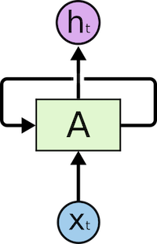
Recall RNNs
The feedback in the state allows for information from one step to pass to the next step

Slide 5

RNNs for Text
Sequence of words in a sentence can pass information from one to the next to allow for accumulated understanding

Slide 6
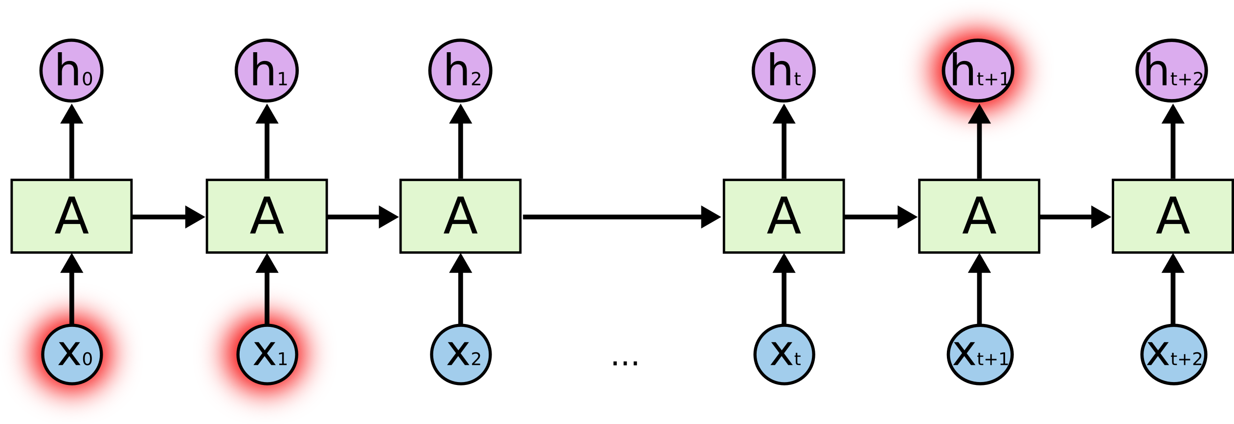
Problem with RNNs for seq-to-seq translation
RNNs have trouble remembering information that is in the past.

Slide 7
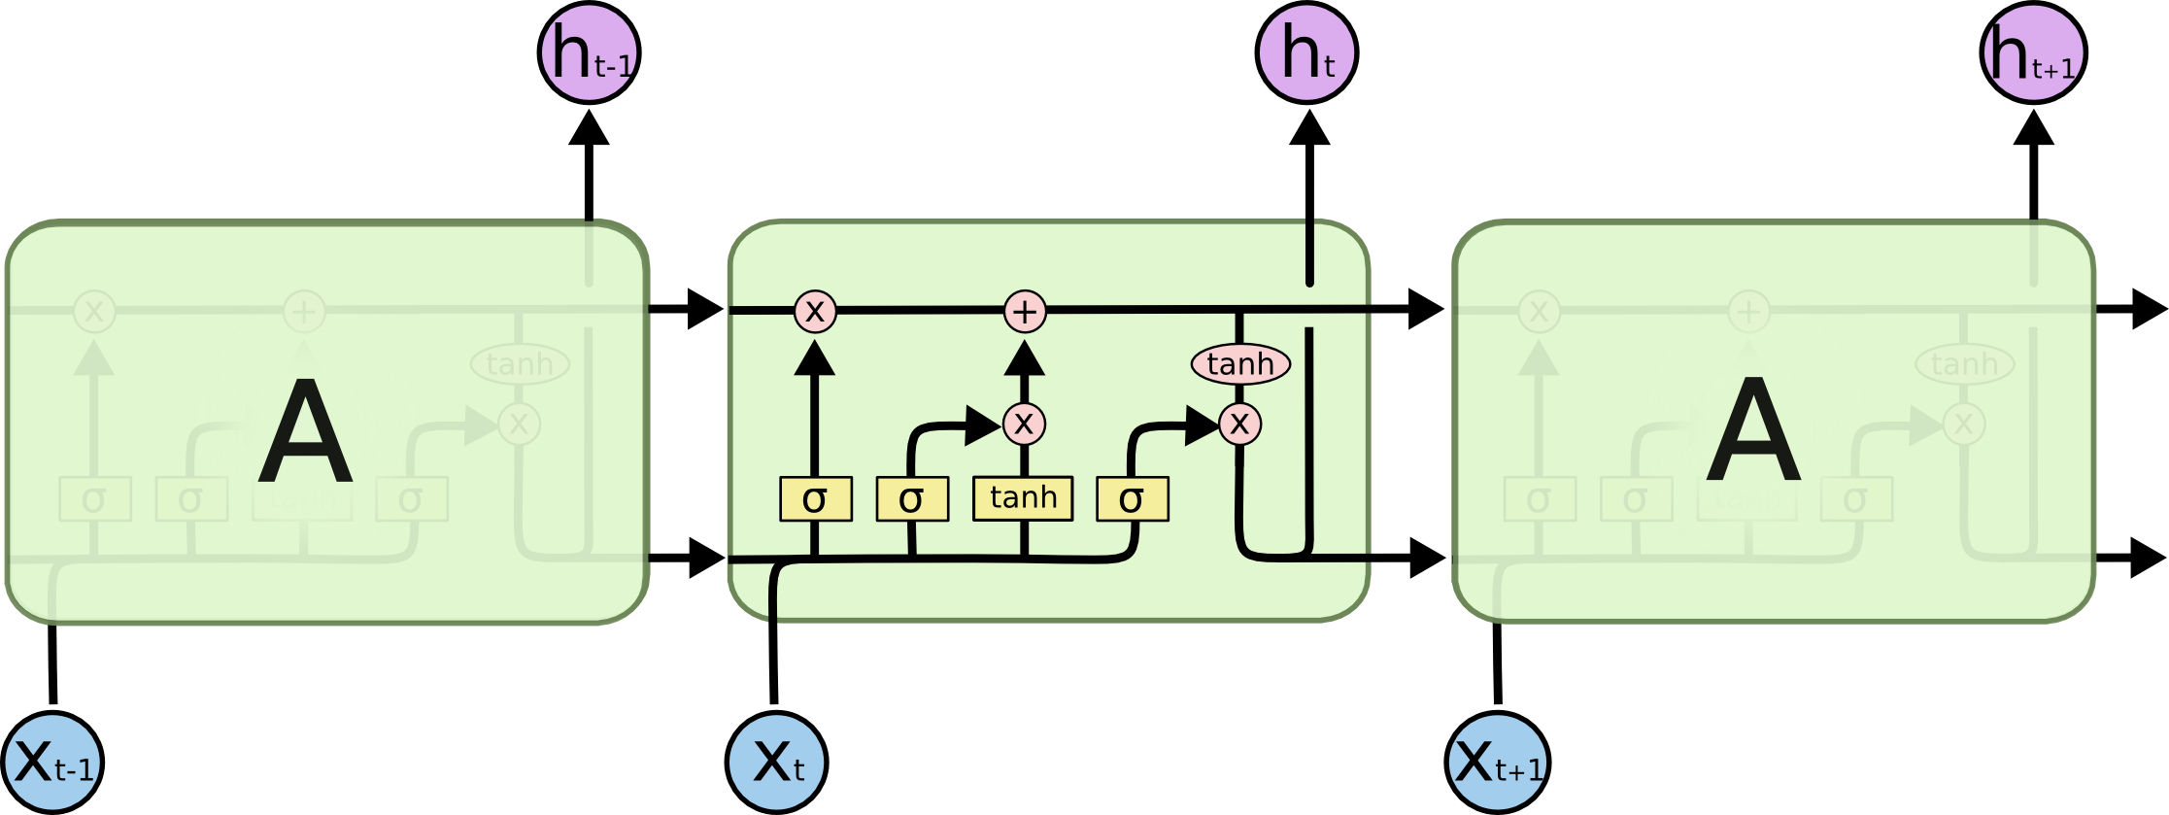
LSTMs don’t fix problem entirely
LSTMs have persistent states that are updated by gates, which improves performance but still not optimal

Slide 9
Transformer: CAE + Attention

Slide 10
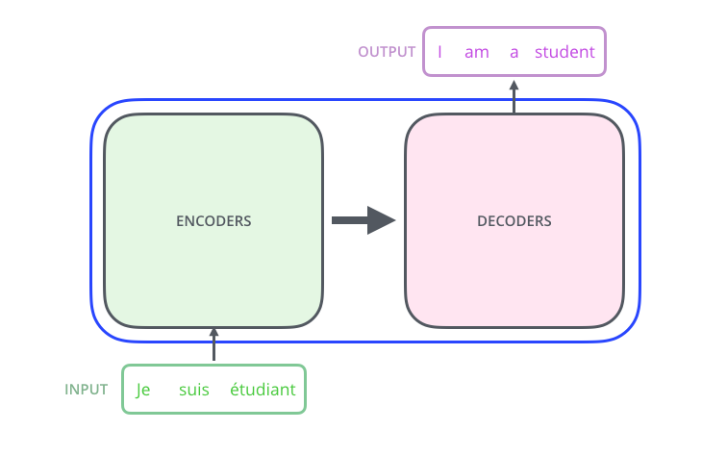
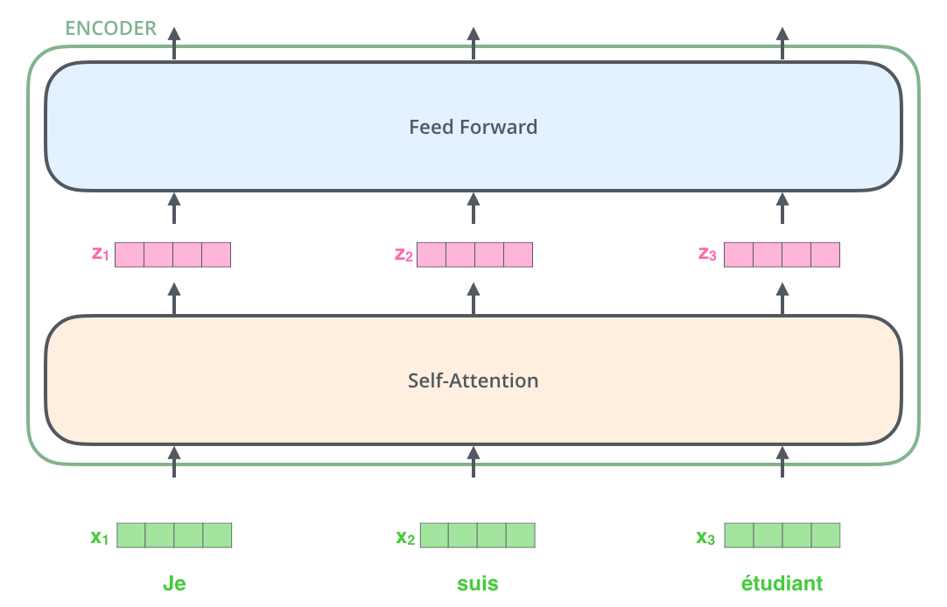
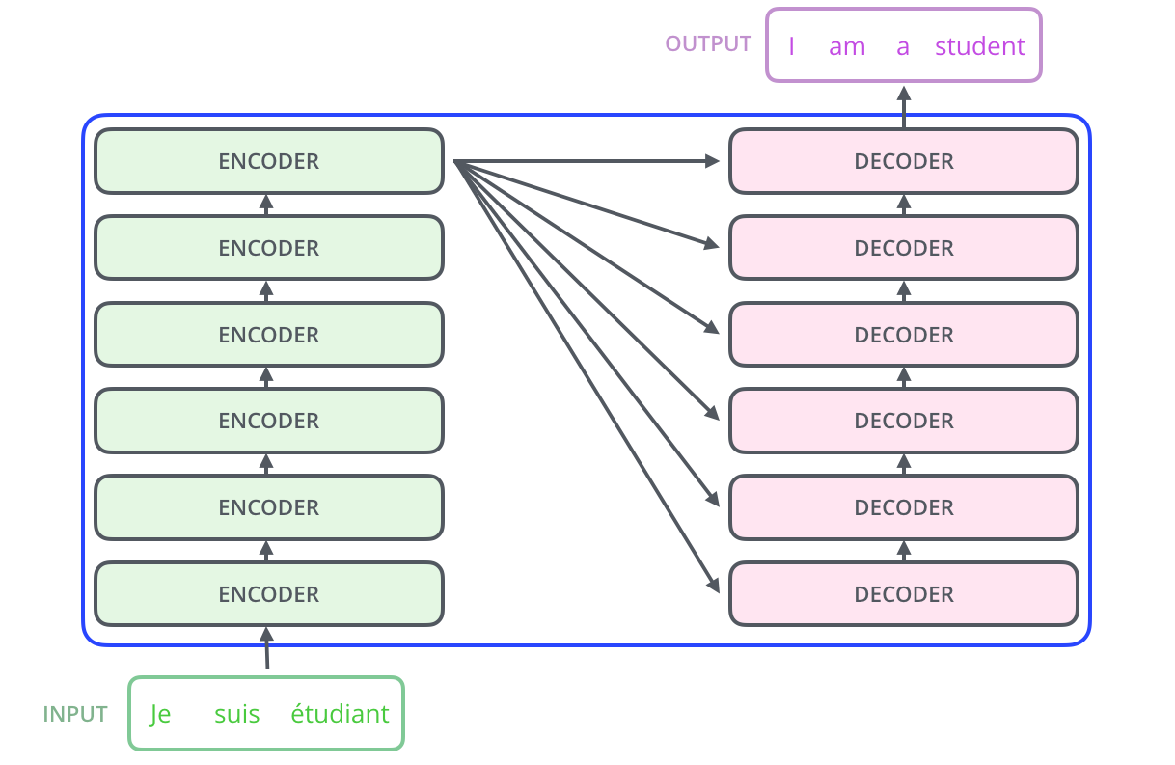
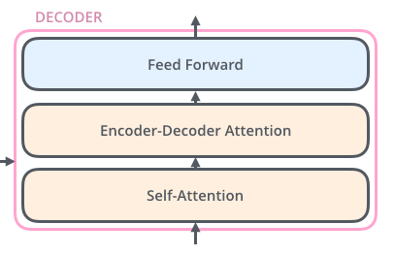
Architecture (simplified)
Encoder
Decoder

Slide 11
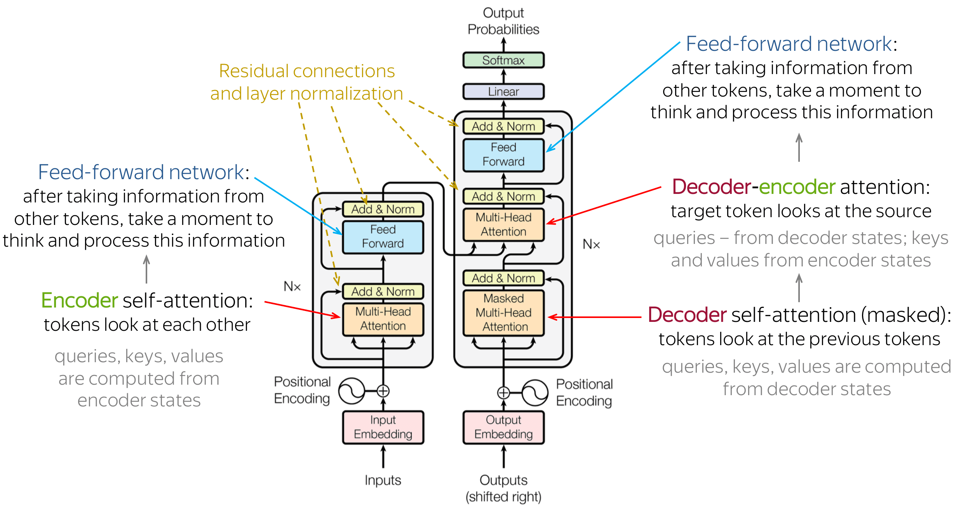
Architecture

Slide 12
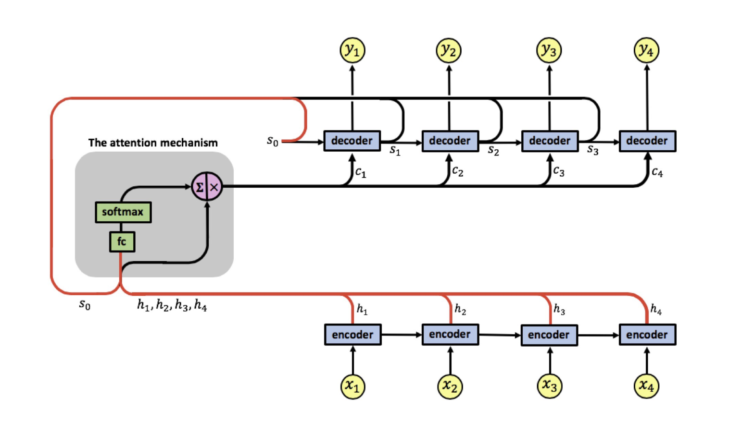
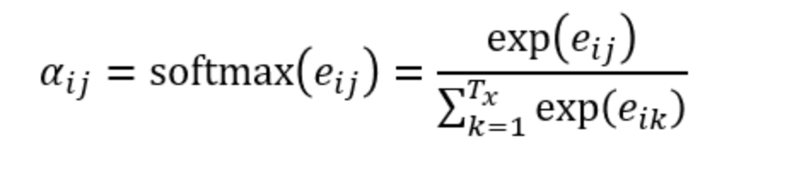
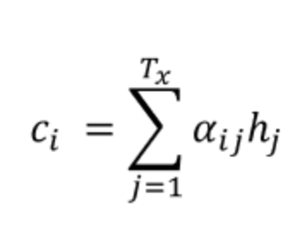
Attention: Adaptively Allows Decoder to Choose Inputs

Slide 13
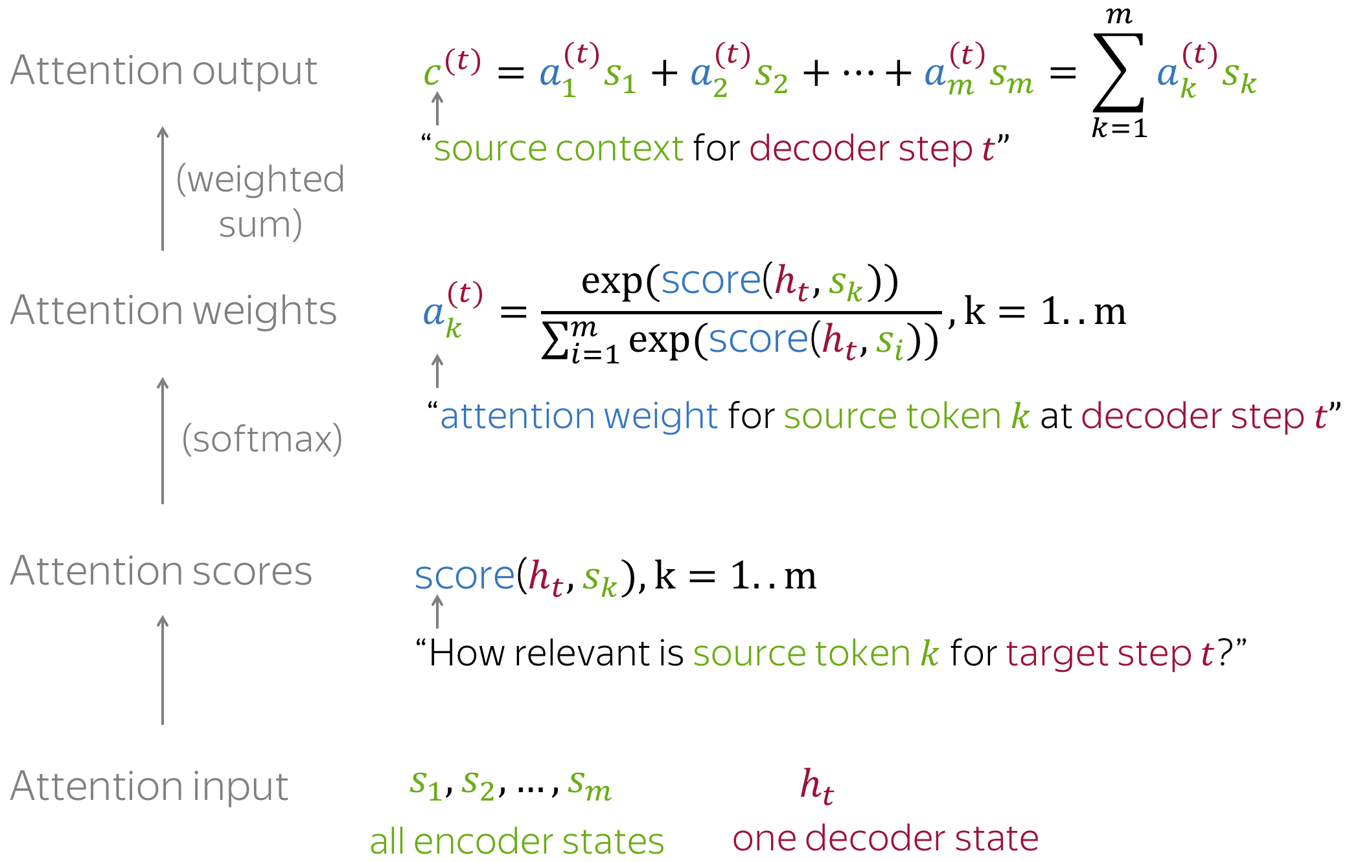
Attention Computations

Slide 14
Attention Weights

Slide 15
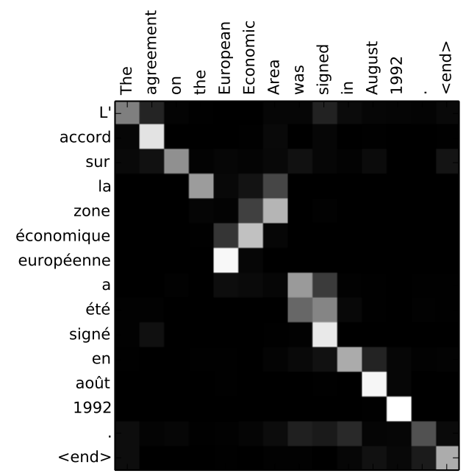
Attention Mechanisms

Slide 16
CNNs for sequences
Easy to parallelize
Can exploit dependences
Distance between positions is logarithmic

Slide 17
Each Encoder has Self-Attention

Slide 18
Each Decoder also has self-attention

Slide 19
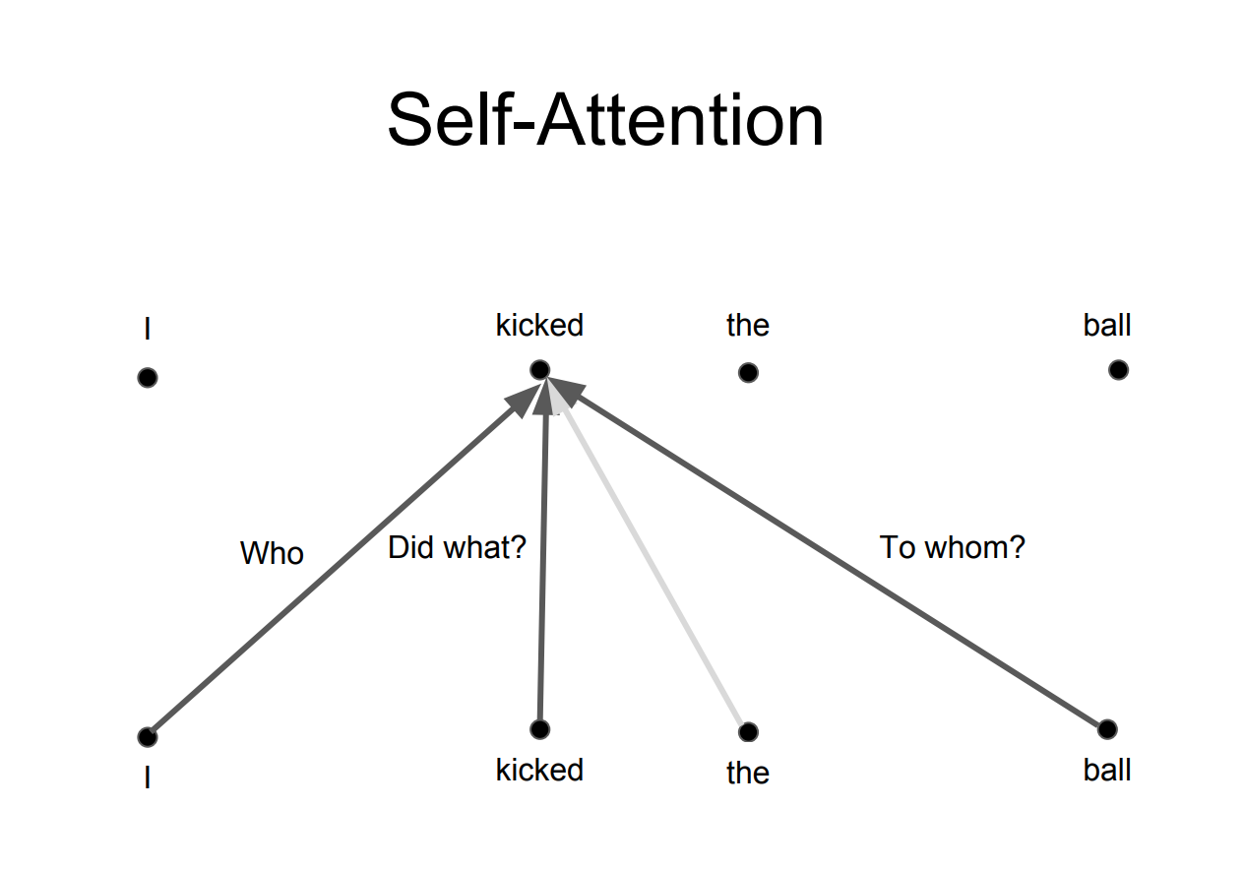
Self Attention

Slide 20
Self-Attention (Filing Cabinet Analogy)

Slide 21
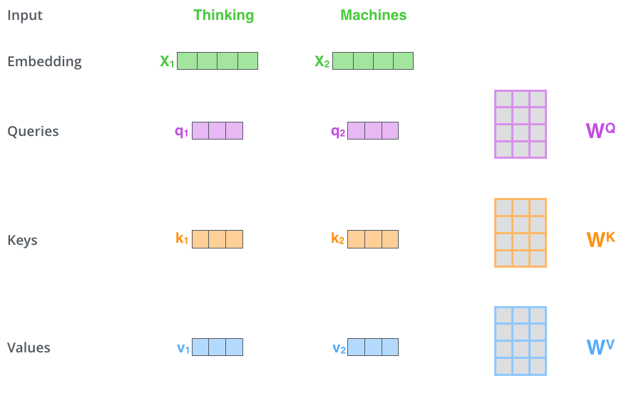
Query, Key, Value

Slide 22
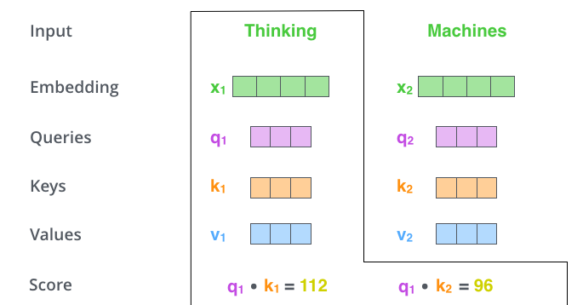

Slide 23
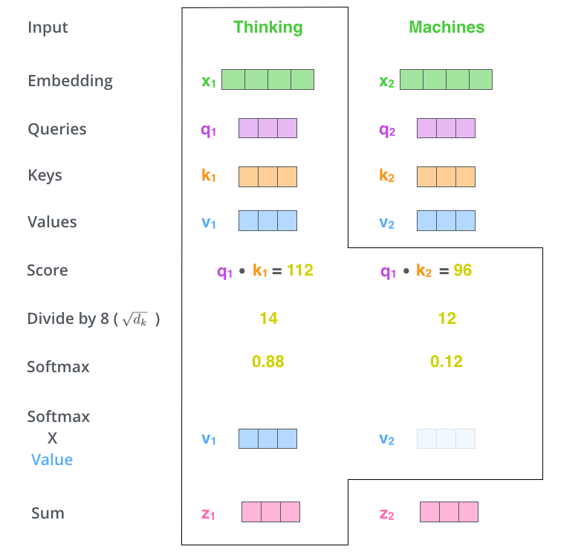
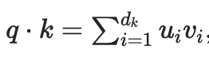
Why the scaling?
Assuming q and k are d_{k} dimensional vectors
The dot product is
This has mean 0 and variance d_{k}
Want to normalize to have variance 1

Slide 24
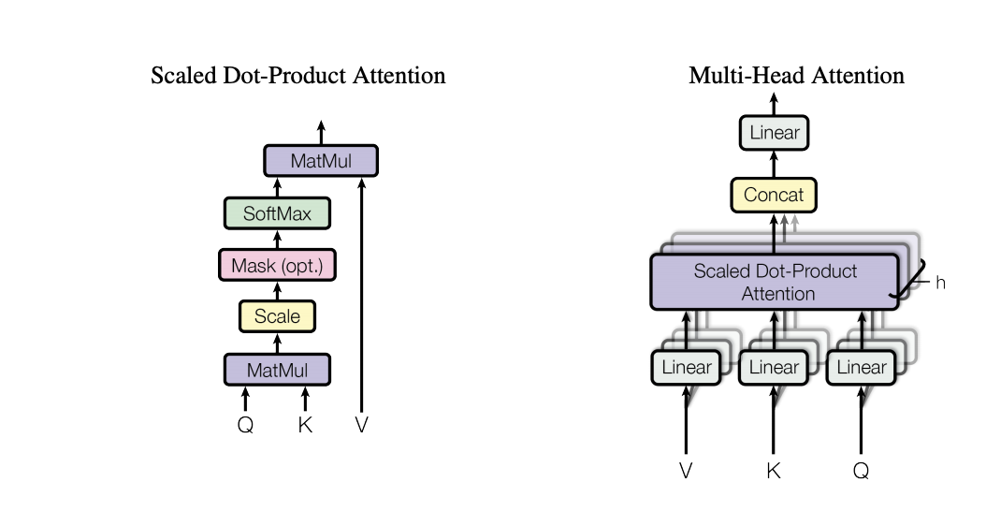
Multihead Attention
From Vasvani et al.

Slide 25
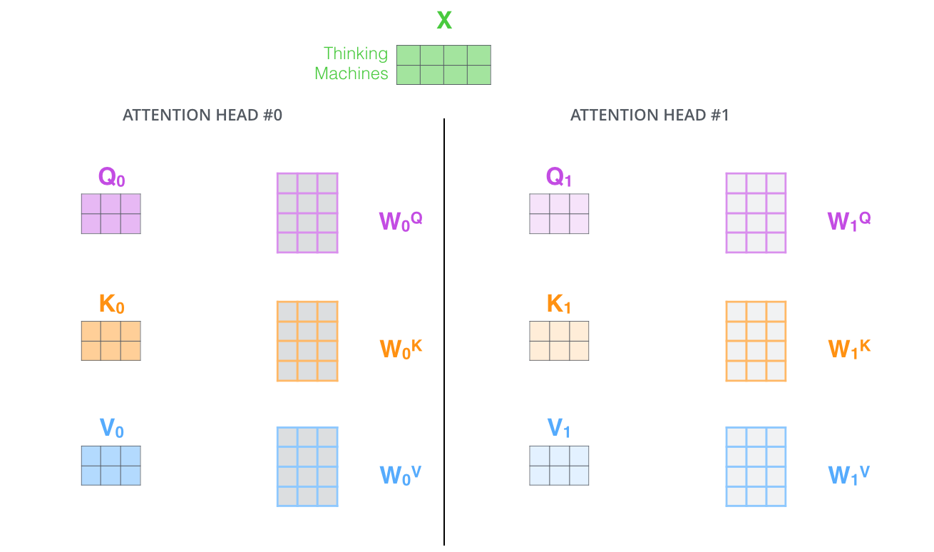
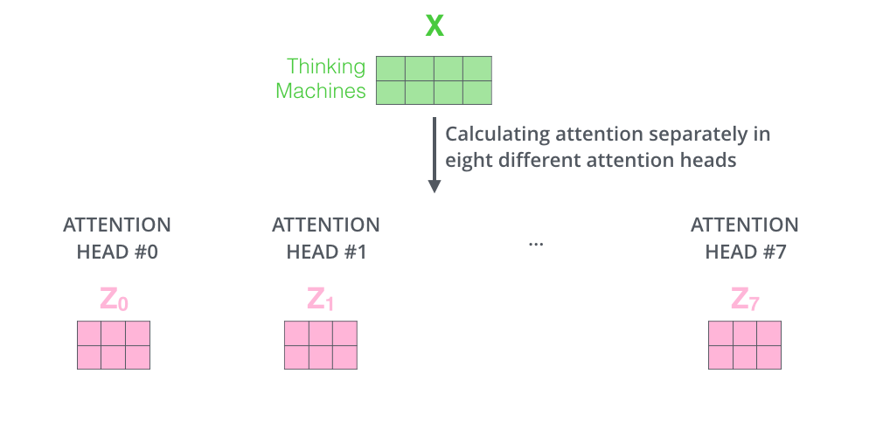
Multi-head Attention

Slide 26
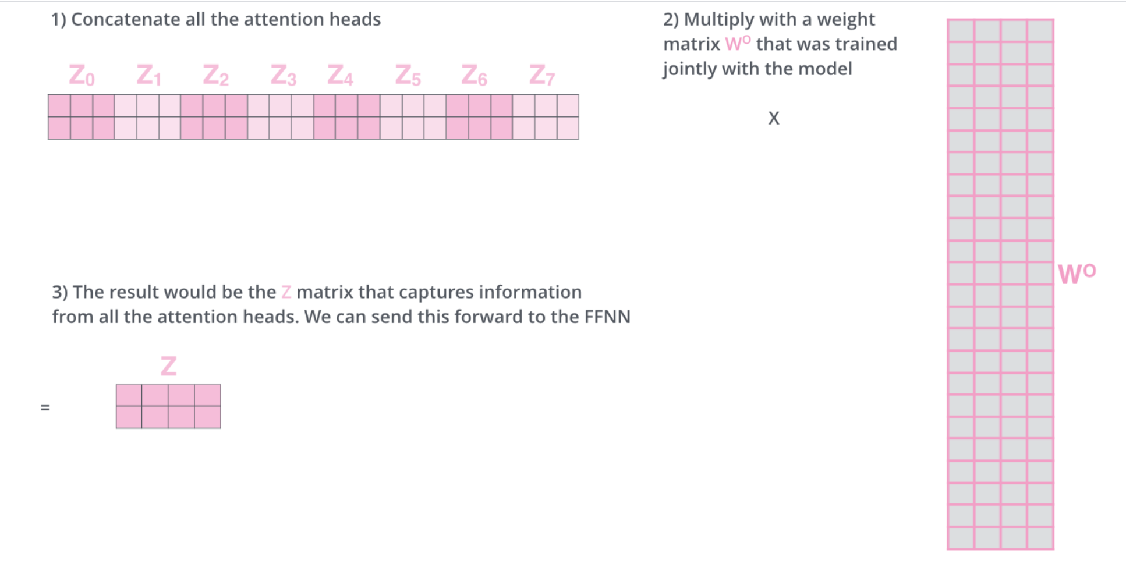
Concatenating Multi-head Attention

Slide 27
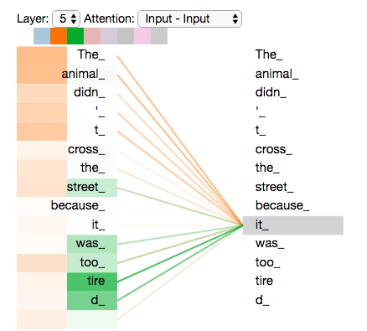
Attention Results

Slide 28
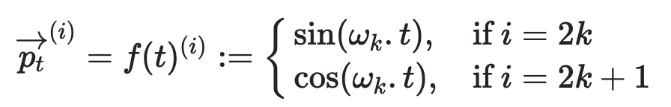
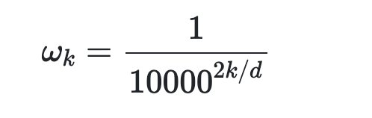
Positional Encoding
Lost positional information now
Positions can’t be encoded by numbers because sequences of different lengths can’t be trained this way
Instead use a periodic function like sin, cos to create the embedding

Slide 29
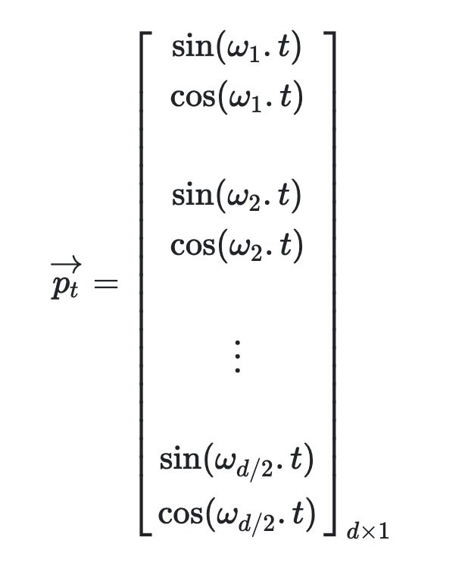
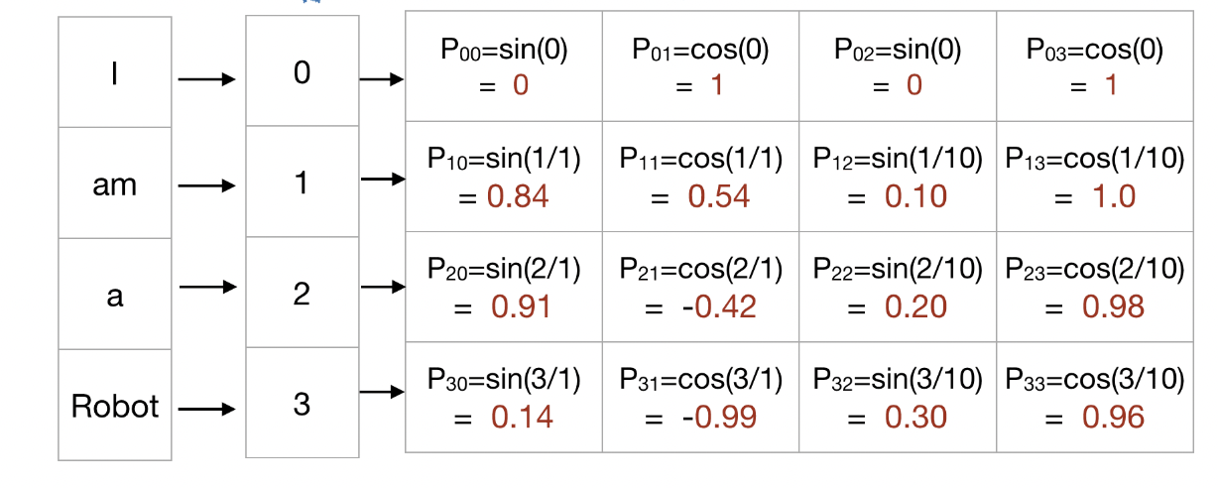
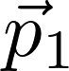
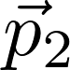
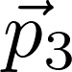
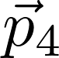
Total positional encoding
d_model
sequence
position t

Slide 30
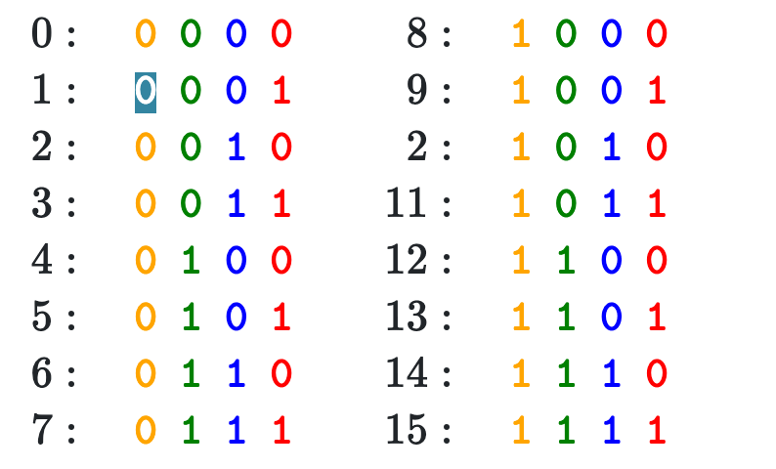
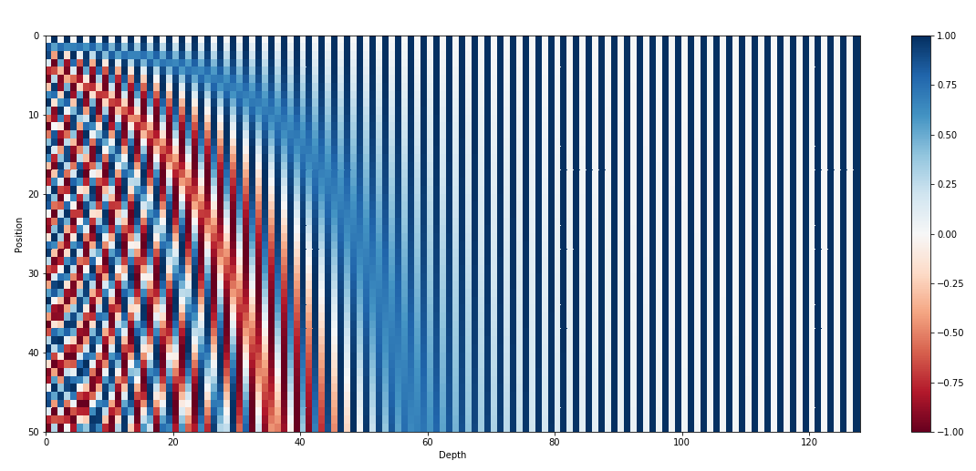
Binary vs Positional Encoding

Slide 31
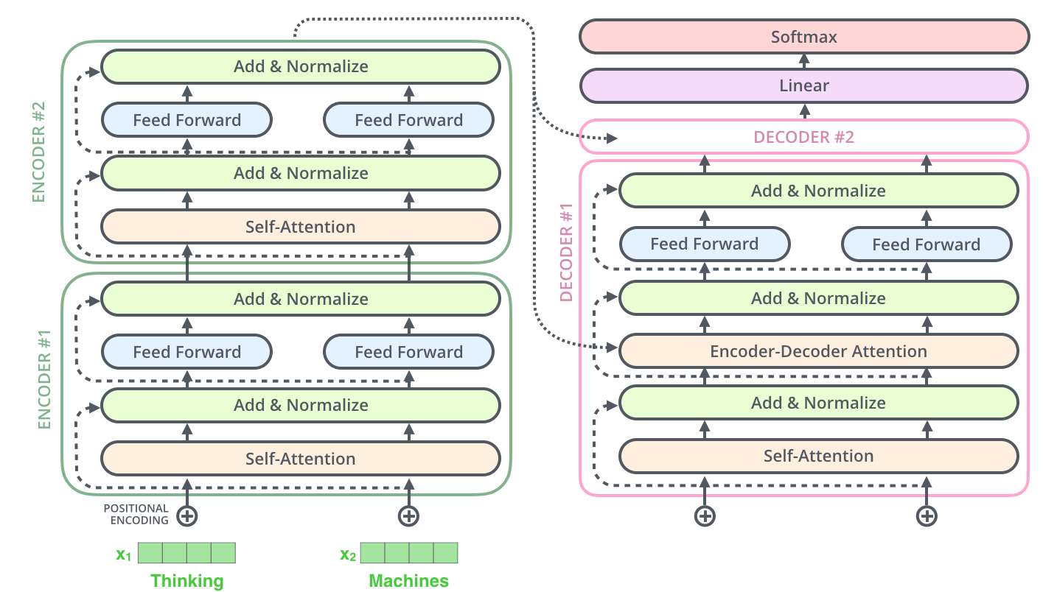
Transformer
Residuals

Slide 32
Computation in a Transformer

Slide 33
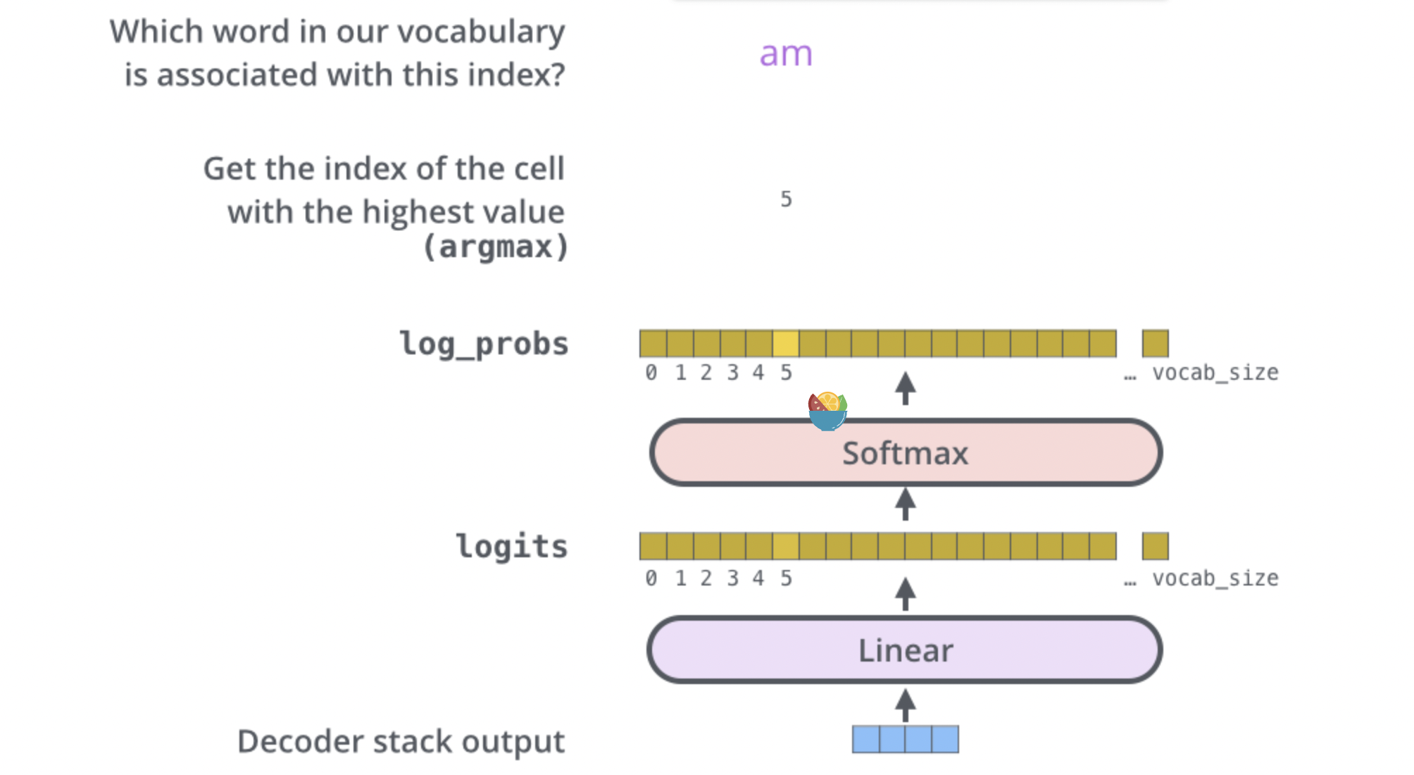
final linear layer and softmax layer

Slide 34
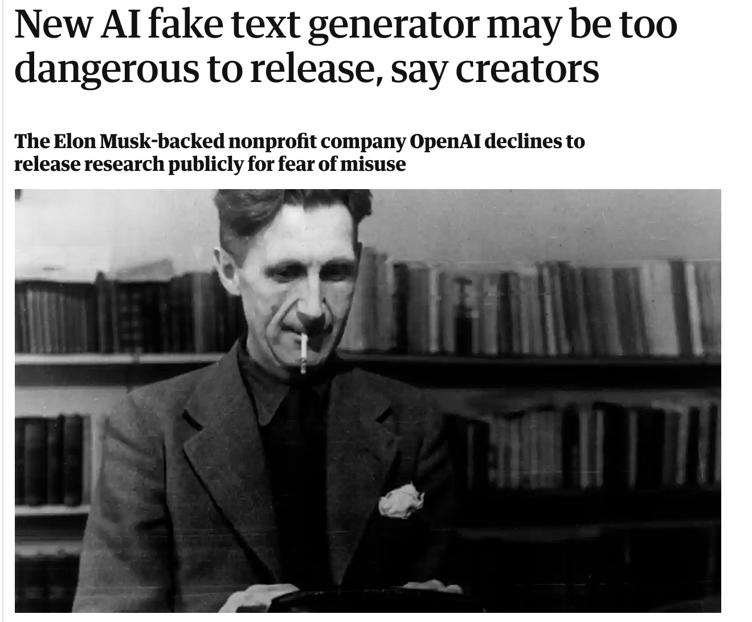

Slide 35
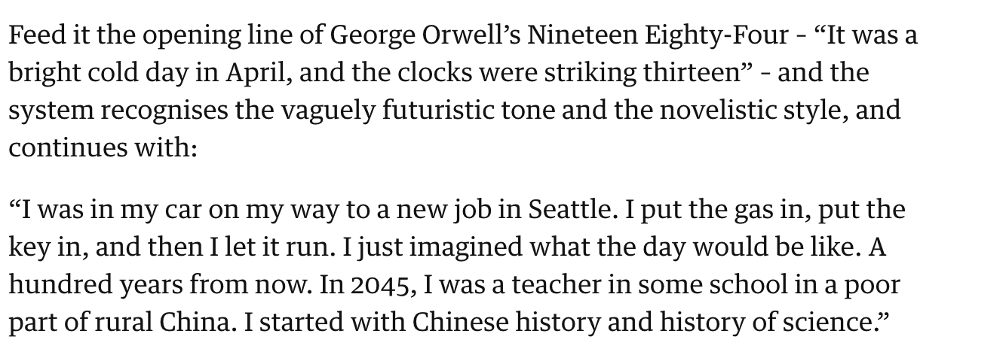

Slide 36
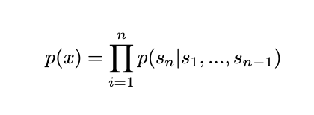
Language Modeling
An unsupervised training task that models the probability of a word given its context
Instead of task-oriented training language models are just trained to predict probabilities from corpuses

Slide 37
Reading list
https://towardsdatascience.com/attention-and-its-different-forms-7fc3674d14dc
http://jalammar.github.io/illustrated-transformer/
Vaswani et al. 2019 https://arxiv.org/abs/1706.03762
Radford et al. (GPT2 paper)
Brown et al. (GPT3 paper)
Child et al. (Sparse Transformer)
https://jalammar.github.io/illustrated-gpt2/
https://medium.com/walmartglobaltech/the-journey-of-open-ai-gpt-models-32d95b7b7fb2

